Slide 1
African Independence
Maps

Slide 2
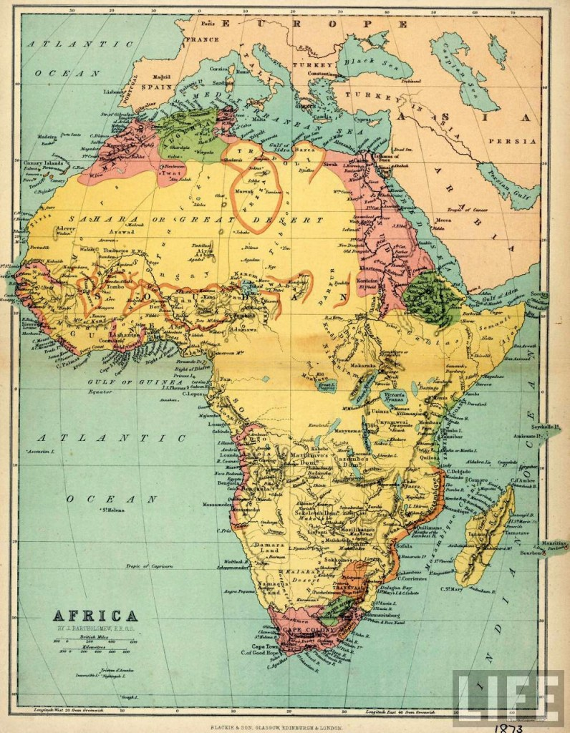

Slide 3
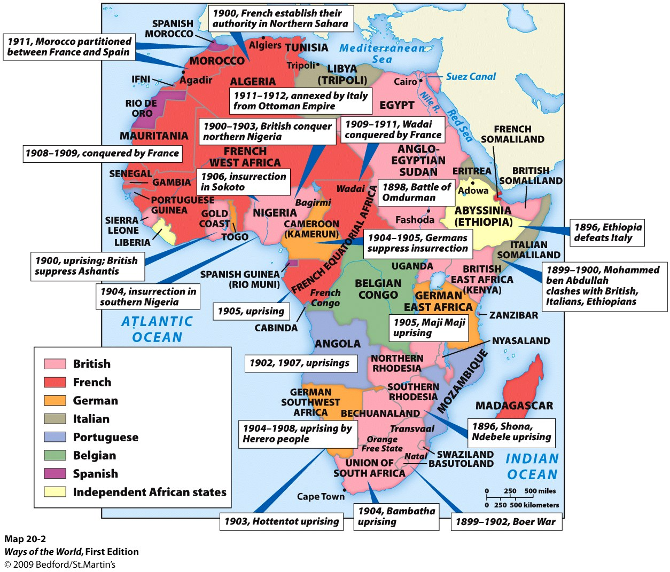
FOCUS QUESTION
In what ways was the “scramble” for furniture similar to the experiences of the European Colonial Powers in Africa?

Slide 4
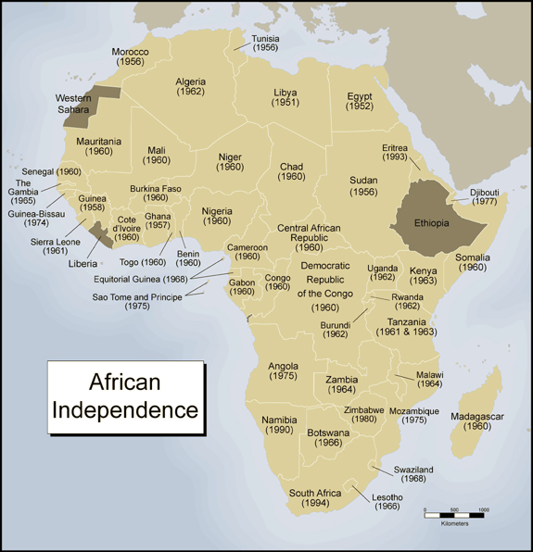

Slide 5
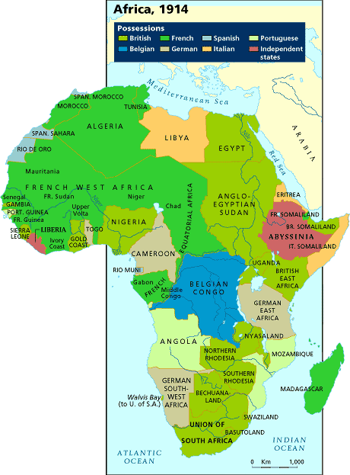
What a difference 100 years makes!
African Empires, 1000CE -1800CE
Notes:
How did it happen? Why did it happen? Problems it may have caused then and today.

Slide 6
AFRICAN INDEPENDENCE

Slide 7
